Slide 1
Pattern Recognition CSE 467
Classification: Linear Classifier

Slide 2



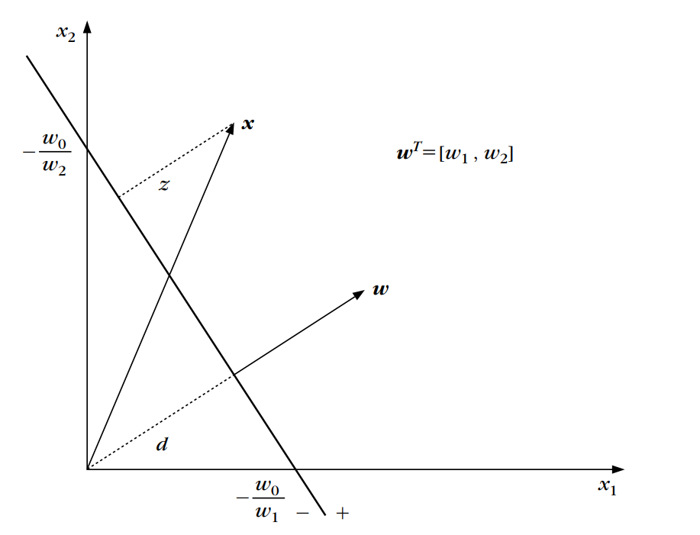

Linear Discriminant Functions And Decision Hyperplanes
Decision Hyper surface for a l dimensional dataset
-> threshold
Here,
-> weight vector ,
$g\left(x\right)= w_{1}x_{1}+$ $w_{2}x_{2}+$ $w_{0}$
2

Slide 3

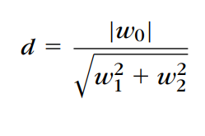
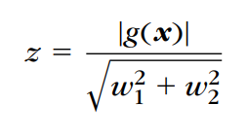

Linear Discriminant Functions And Decision Hyperplanes
If x1, x2 are two points on the decision hyperplane, then the following is valid
One Side: g(x) > 0 (+)
Other Side: g(x) < 0 (-)
w is orthogonal to the decision hyperplane
$g\left(x\right)= w_{1}x_{1}+$ $w_{2}x_{2}+$ $w_{0}$
3

Slide 4
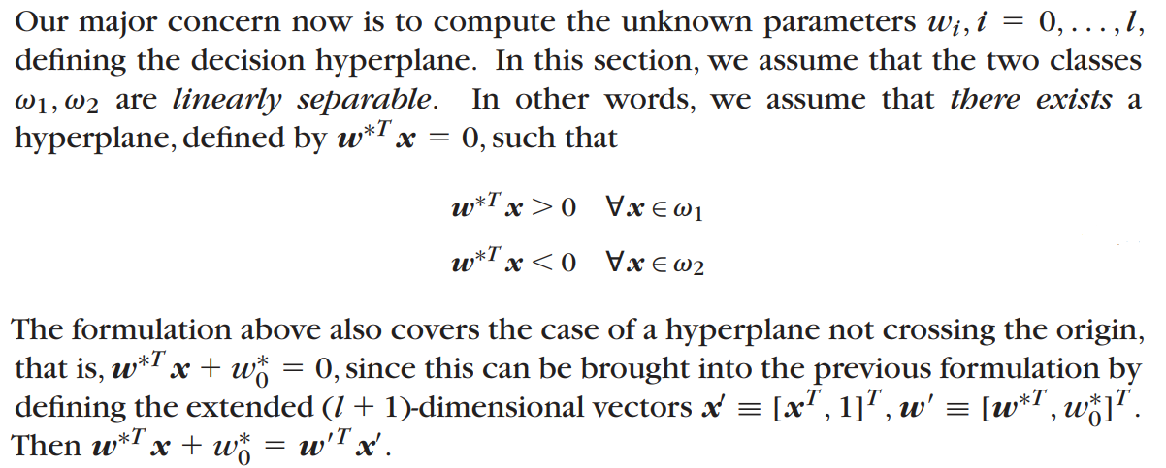
Linear Discriminant Functions And Decision Hyperplanes
4

Slide 5
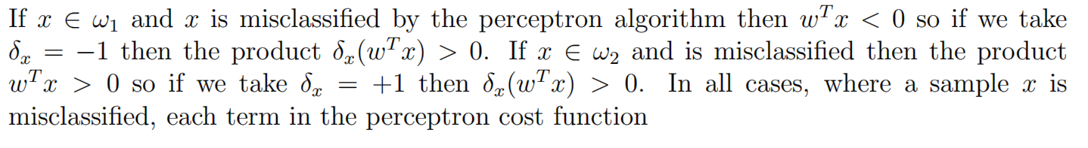
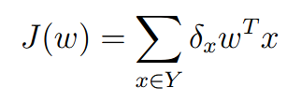
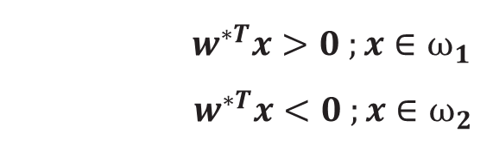
Perceptron Algorithm (Cost Function)
$w^{∗T}x>0 ;x∈ω_{1}$
$w^{∗T}x<0 ;x∈ω_{2}$
J(w) is always positive
5

Slide 6
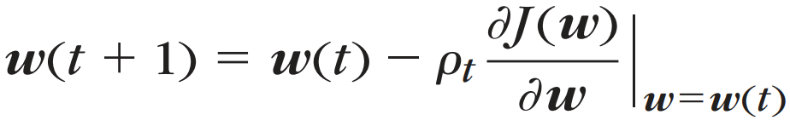
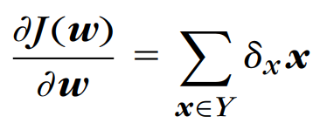

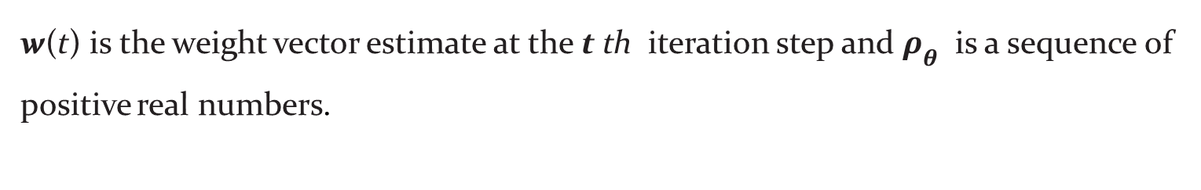
Perceptron Algorithm (Cost Function)
To derive the algorithm for the iterative minimization of the cost function, we will adopt an iterative scheme in the spirit of the gradient descent method, that is,
w(t) is the weight vector estimate at the t th iteration step and $ρ_{θ}$ is a sequence of positive real numbers.
6

Slide 7
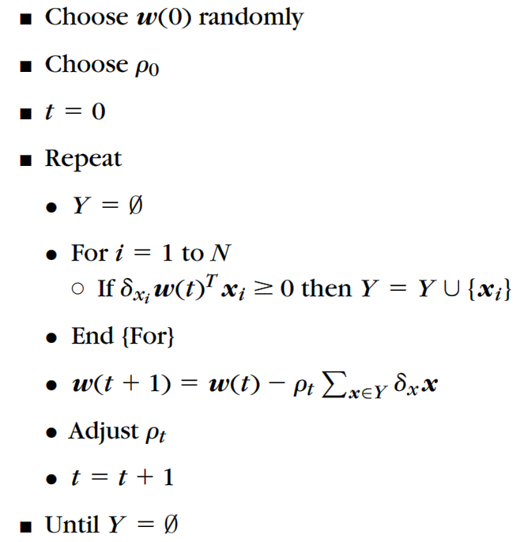
The Perceptron Algorithm
7

Slide 8
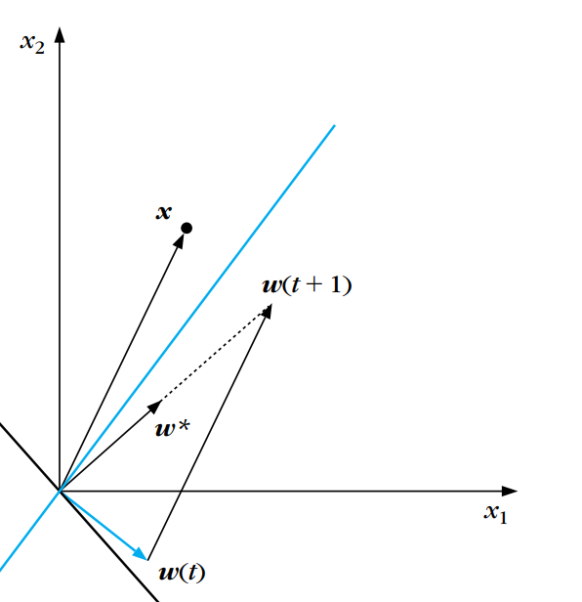
Finding Best Weight in the above Perceptron Algorithm
Example 3.1
8

Slide 9
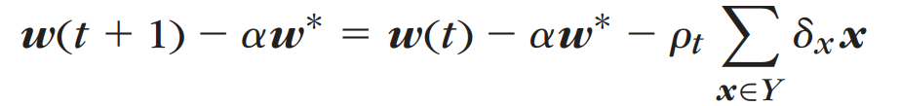
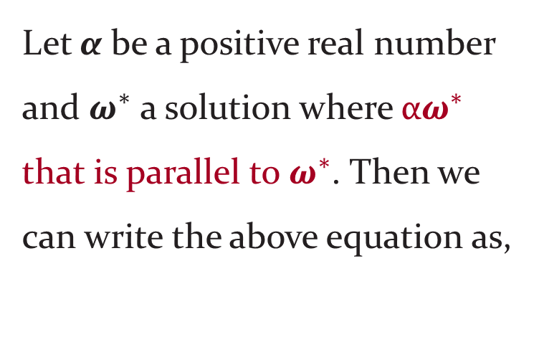
Convergence of Perceptron algorithm (Proof)
Let α be a positive real number and $ω^{∗}$ a solution where α$ω^{∗}$ that is parallel to $ω^{∗}$. Then we can write the above equation as,
9

Slide 10
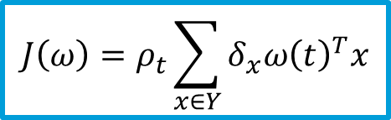
Convergence of Perceptron algorithm (Proof)
Then squaring both sides of the above we get,
$${|\left|ω\left(t+1\right)− αω^{∗}\right||}^{2}={|\left|ω\left(t\right)− αω^{∗}\right||}^{2}+{ρ_{t}^{2}||\sum_{x∈Y}{δ_{x}x||}}^{2}−2ρ_{t}\sum_{x∈Y}{δ_{x}{ω\left(t\right)}^{T}x}+2ρ_{t}\sum_{x∈Y}{δ_{x}{{αω}^{∗}}^{T}x}$$
$${J\left(ω\right)=ρ}_{t}\sum_{x∈Y}{δ_{x}{ω\left(t\right)}^{T}x}$$
10

Slide 11

Convergence of Perceptron algorithm (Proof)
$${|\left|ω\left(t+1\right)− αω^{∗}\right||}^{2}={|\left|ω\left(t\right)− αω^{∗}\right||}^{2}+{ρ_{t}^{2}||\sum_{x∈Y}{δ_{x}x||}}^{2}−2ρ_{t}\sum_{x∈Y}{δ_{x}{ω\left(t\right)}^{T}x}+2ρ_{t}\sum_{x∈Y}{δ_{x}{{αω}^{∗}}^{T}x}$$
$${J\left(ω\right)=ρ}_{t}\sum_{x∈Y}{δ_{x}{ω\left(t\right)}^{T}x}$$
11

Slide 12

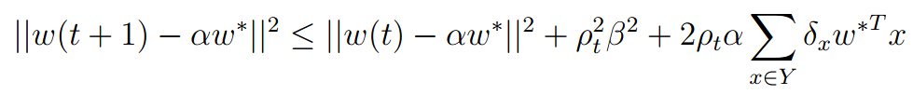
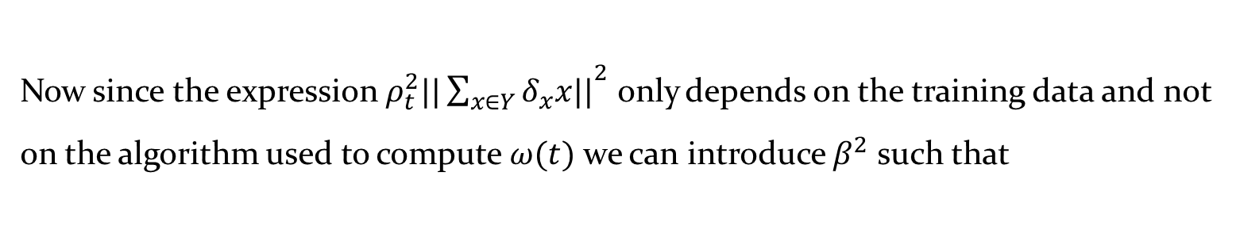
Convergence of Perceptron algorithm (Proof)
Now since the expression ${ρ_{t}^{2}||\sum_{x∈Y}{δ_{x}x||}}^{2}$ only depends on the training data and not on the algorithm used to compute $ω(t)$ we can introduce $β^{2}$ such that
thus $β^{2}$ is the largest possible value for the given sum. At this point we have,
12

Slide 13

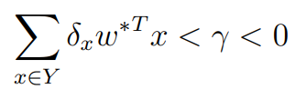

Convergence of Perceptron algorithm (Proof)
For any fixed set Y we then have
by the definition of $γ$ Now since γ < 0 we can write γ = -|γ| and thus have
13

Slide 14
Convergence of Perceptron algorithm (Proof)
by the definition of $γ$ Now since γ < 0 we can write γ = -|γ| and thus have
Using this result we thus are able to bound ${|\left|ω\left(t+1\right)− αω^{∗}\right||}^{2}$ as
14

Slide 15

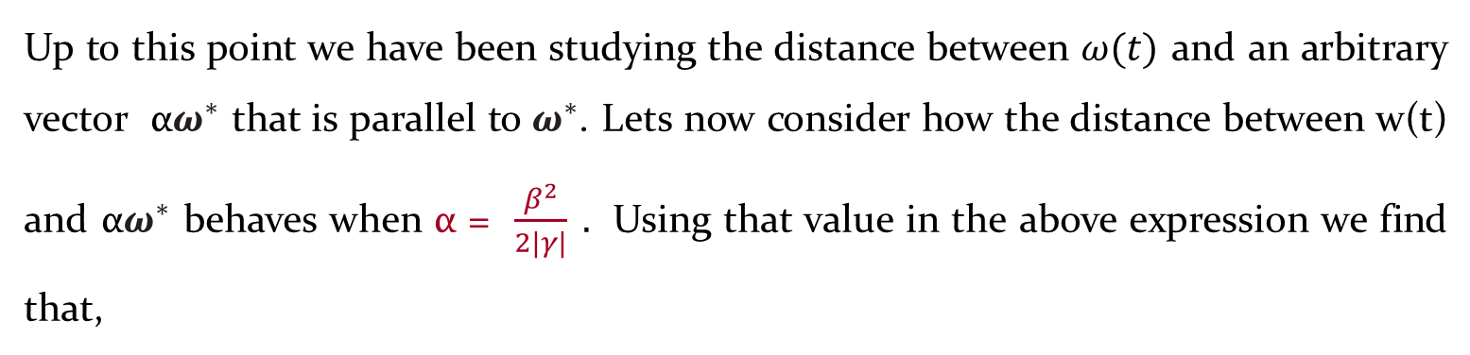
Convergence of Perceptron algorithm (Proof)
Up to this point we have been studying the distance between $ω(t)$ and an arbitrary vector α$ω^{∗}$ that is parallel to $ω^{∗}$. Lets now consider how the distance between w(t) and α$ω^{∗}$ behaves when α = $\frac{β^{2}}{2|γ|} .$ Using that value in the above expression we find that,
and the bound above become
15

Slide 16
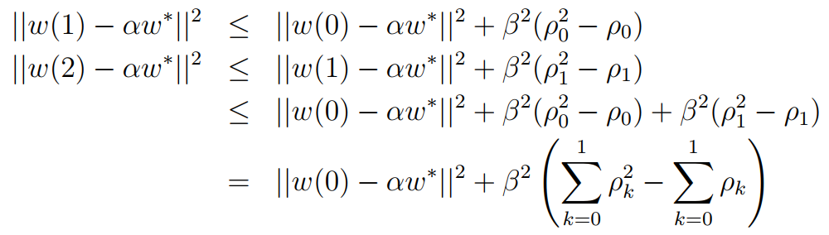

Convergence of Perceptron algorithm (Proof)
Writing out these expressions for t = 0, 1, 2, . . . gives
16

Slide 17
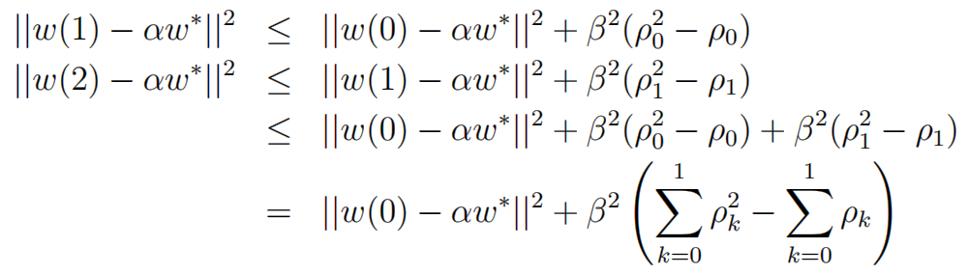
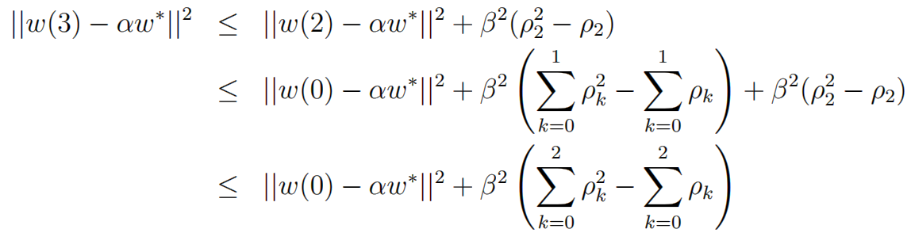
Convergence of Perceptron algorithm (Proof)
17

Slide 18
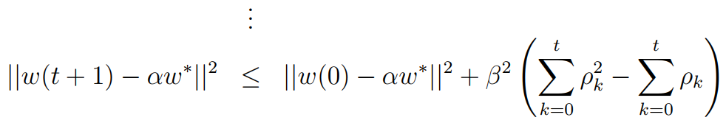
Convergence of Perceptron algorithm (Proof)
18

Slide 19
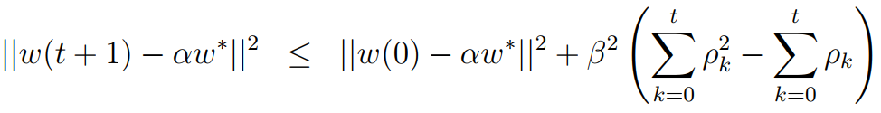
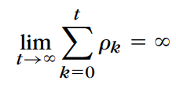
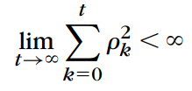

Convergence of Perceptron algorithm (Proof)
--------------------------------------------(1)
If the sequence of $ρ_{t}$ is chosen to satisfy the following two conditions:
And
then there will be a constant $t_{0}$such that the right-hand side of (1) becomes non-positive. Thus ,
$${0≤|\left|ω\left(t_{0}+1\right)− αω^{∗}\right||}^{2}≤0$$
19

Slide 20

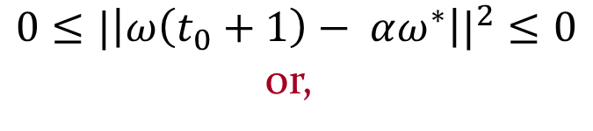

Convergence of Perceptron algorithm (Proof)
$${0≤|\left|ω\left(t_{0}+1\right)− αω^{∗}\right||}^{2}≤0$$
or,
$$0≤|\left|ω\left(t_{0}+1\right)− αω^{∗}\right||≤0$$
Proved
20

Slide 21
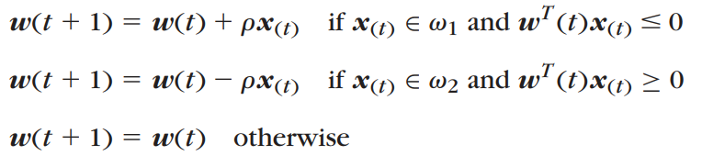
Variants of Perceptron algorithm
The algorithm belongs to a more general algorithmic family known as reward and punishment schemes. If the classification is correct, the reward is that no action is taken. If the current vector is misclassified, the punishment is the cost of correction. It can be shown that this form of the perceptron algorithm also converges in a finite number of iteration steps (Problem3.3).
21

Slide 22
The Pocket Algorithm
A basic requirement for the convergence of the perceptron algorithm is the linear separability of the classes. If this is not true, as is usually the case in practice, the perceptron algorithm does not converge. A variant of the perceptron algorithm was suggested in [Gal 90] that converges to an optimal solution even if the linear separability condition is not fulfilled. The algorithm is known as the pocket algorithm and consists of the following two steps:
■ Initialize the weight vector w(0) randomly. Define a stored (in the pocket!) vector ws. Set a history counter hs of the ws to zero.
■ At the t th iteration step compute the update w(t + 1), according to the perceptron rule. Use the updated weight vector to test the number h of training vectors that are classified correctly. If h > hs replace ws with w(t+1) and hs with h. Continue the iterations.
22

Slide 23
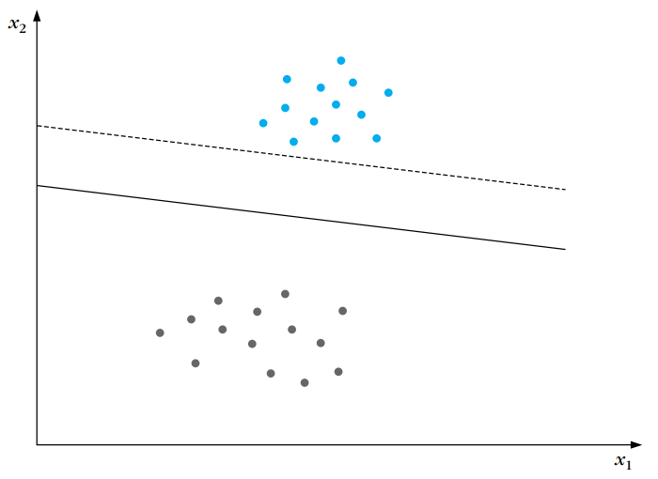
Linear Support Vector Machine (Motivation)
23

Slide 24
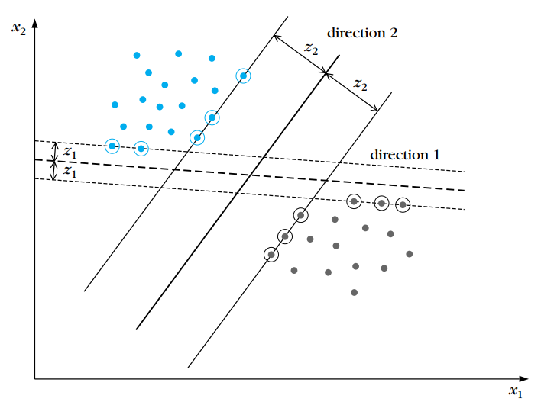
Linear Support Vector Machine
“Our goal is to search for the direction that gives the maximum possible margin”
24

Slide 25



The distance of a point from a hyperplane is given by
$w_{1}x_{1}+$ $w_{2}x_{2}+$ $w_{0}=0$
$g\left(x\right)= w_{1}x_{1}+$ $w_{2}x_{2}+$ $w_{0}$
4/21/2022
25

Slide 26






Linear Support Vector Machine
$|g\left(x\right)|=|w_{1}x_{1}+$ $w_{2}x_{2}+$ $w_{0}|$
${\text{z}}_{2}$=
4/21/2022
26

Slide 27
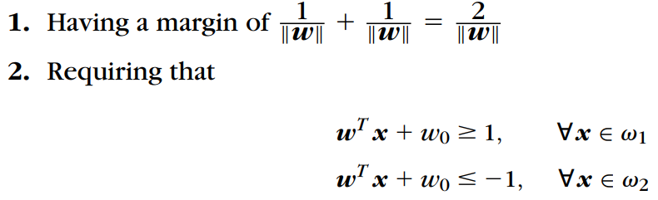
Linear Support Vector Machine
4/21/2022
27

Slide 28


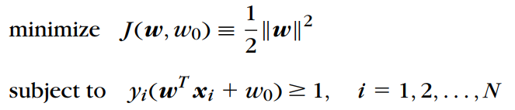
Linear Support Vector Machine
4/21/2022
28

Slide 29


Linear Support Vector Machine
In order to find the maximum or minimum of a function f(x)=0, subjected to the equality constraint g(x)=0 form the Lagrangian function
L(x,λ)=f(x)- λ g(x)
The necessary conditions for its minimum are given by the Karush-Kuhn-Tucker (KKT) conditions. To introduce these we need to form the Lagrangian L given by,
4/21/2022
29

Slide 30

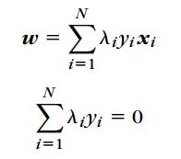
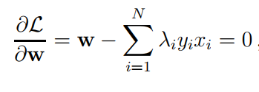

Linear Support Vector Machine
The necessary conditions for its minimum are given by the Karush-Kuhn-Tucker (KKT) conditions. To introduce these we need to form the Lagrangian L given by,
Then the KKT conditions for the above problem are:
4/21/2022
30

Slide 31
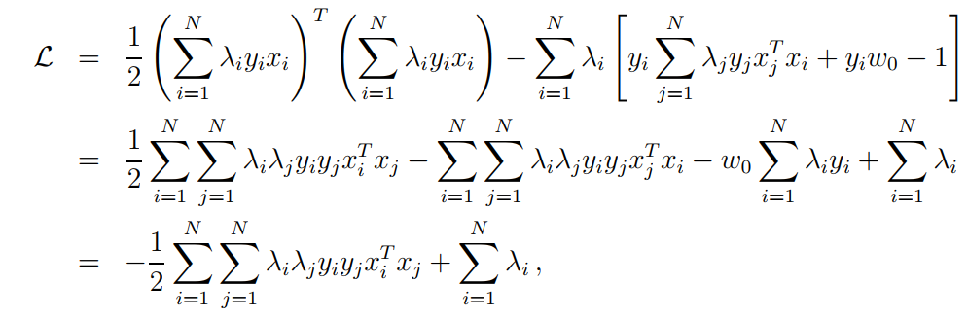
Linear Support Vector Machine
4/21/2022
31

Slide 32
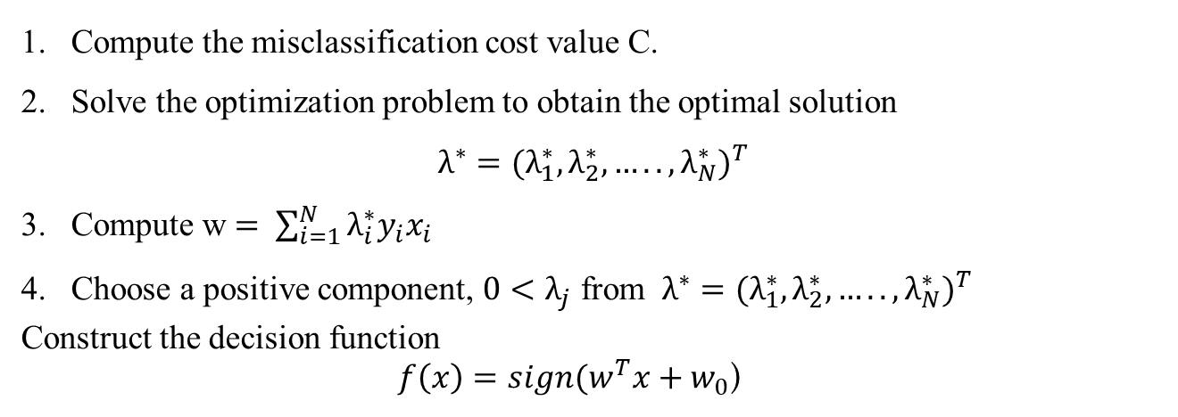
Linear Support Vector Machine
Compute the misclassification cost value C.
Solve the optimization problem to obtain the optimal solution $λ^{∗}={(λ_{1}^{∗},λ_{2}^{∗}, …..,λ_{N}^{∗})}^{T}$
Compute w $= \sum_{i=1}^{N}{λ_{i}^{∗}y_{i}x_{i}}$
Choose a positive component, $0<λ_{j}$ from $λ^{∗}={(λ_{1}^{∗},λ_{2}^{∗}, …..,λ_{N}^{∗})}^{T}$
Construct the decision function $f\left(x\right)=sign(w^{T}x+w_{0}$)
4/21/2022
32

Slide 33
Thanks To
Sergios Theodoridis &
Konstantinos Koutroumbas

Slide 34
Thank You

